Slide 1
Stenography
CAPSTONE PROJECT
Presented By: Om.M.Dorugade
Student Name : Om.M.Dorugade
College Name & Department : Universal College of Engineering,Computer Engineering

Slide 2
OUTLINE
Problem Statement
Technology used
Wow factor
End users
Result
Conclusion
Git-hub Link
Future scope

Slide 3
Problem Statement
Develop a steganography tool using Python and OpenCV to hide and extract text within images. The tool should encode text into an image by modifying the least significant bit (LSB) of pixel values and decode the hidden text from the image. A 8-bit delimiter marks the end of the hidden message to ensure accurate extraction. The application should provide a GUI (Tkinter) for user interaction, allowing text input, image selection, and encoding/decoding actions.

Slide 4
Technology used
Python – Core programming language used to implement the steganography tool.
OpenCV (cv2) – Handles image processing for encoding and decoding hidden text.
Tkinter – Provides a graphical user interface (GUI) for user interactions.
NumPy – Used for efficient manipulation of image pixel data.
File Dialog (filedialog) – Allows users to select and save image files easily.

Slide 5
Wow factors
Unique Features & Wow Factors 🚀
Highly Secure Encoding – Uses Least Significant Bit (LSB) steganography with a 8-bit delimiter, ensuring accurate text retrieval without corruption.
Noise-Free Hidden Data – The hidden text does not visibly alter the image, making detection extremely difficult.
Custom GUI for Ease of Use – Unlike many CLI-based steganography tools, this project provides a Tkinter GUI for a seamless user experience.
Efficient & Fast Processing – Leveraging OpenCV and NumPy, the encoding and decoding processes are optimized for speed.
Cross-Format Image Support – Works with PNG and JPEG formats, expanding usability compared to tools that only support PNG.

Slide 6
End users
Cybersecurity Enthusiasts – Learn and experiment with data hiding techniques for secure communication.
Journalists & Whistleblowers – Hide sensitive information inside images to avoid detection.
Forensic Experts – Use steganography for investigating digital evidence in cybersecurity cases.
Software Developers & Researchers – Explore image processing and steganography for advanced
applications.
Privacy-Conscious Users – Securely embed private messages in images to protect sensitive data.

Slide 7
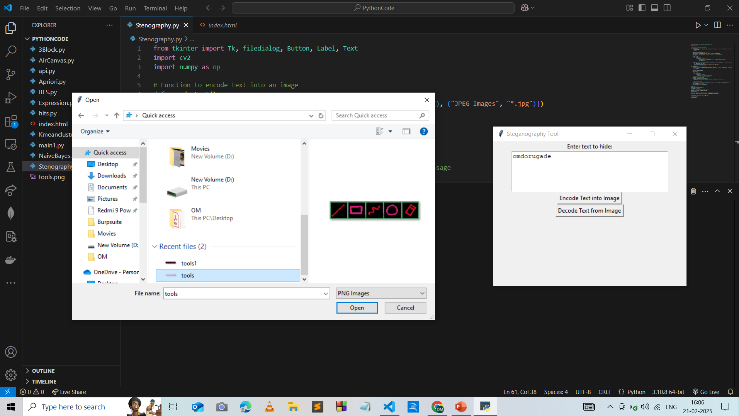
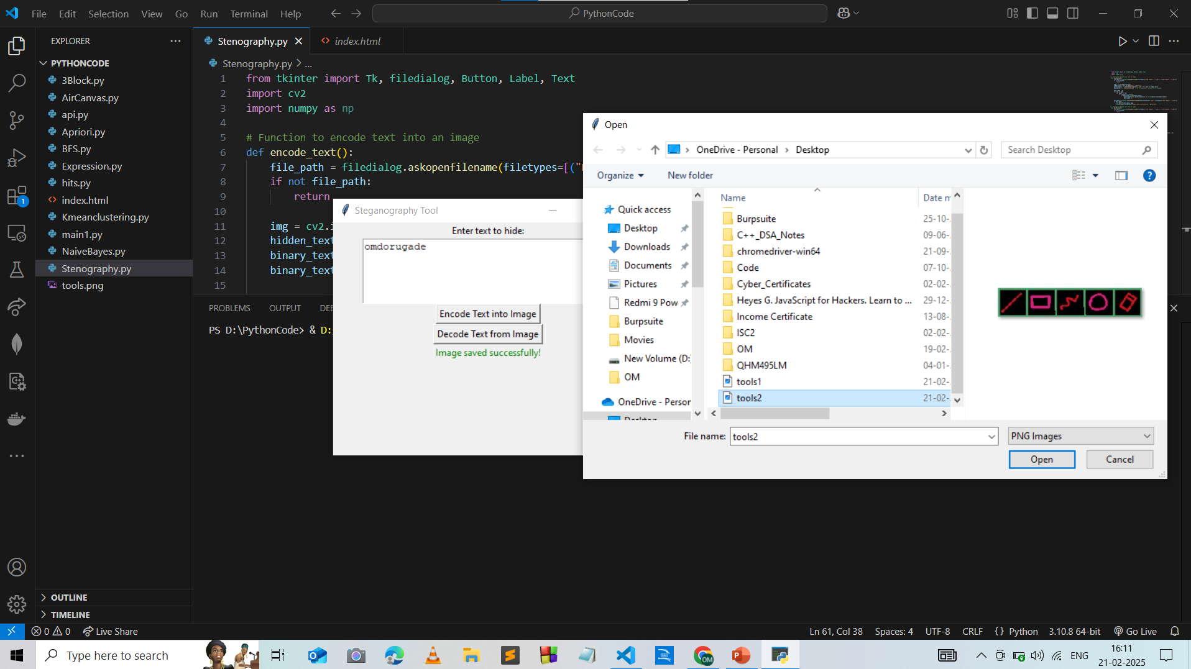
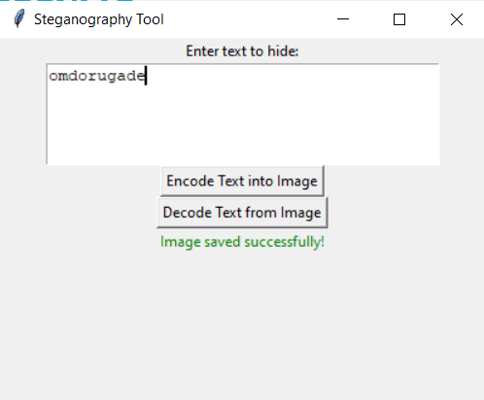
Results

Slide 8
Conclusion
This steganography tool successfully addresses the problem of secure text hiding in images by leveraging Least Significant Bit (LSB) encoding. Using OpenCV and NumPy, the tool efficiently modifies pixel data to embed messages, while a 8-bit delimiter ensures accurate text extraction. The Tkinter-based GUI enhances usability, making encoding and decoding seamless for all users.

Slide 9
GitHub Link
https://github.com/OmDorugade/Stenography

Slide 10
Future scope(optional)
Support for Multiple File Formats – Extend compatibility to BMP, TIFF, and GIF for broader usability.
Encryption Before Encoding – Implement AES or RSA encryption to add an extra security layer before
hiding text.
Video Steganography – Expand functionality to hide text within video frames instead of just images.
Mobile & Web Integration – Develop a mobile app or web-based version for easier access and usability.
AI-Powered Steganalysis Detection – Implement deep learning-based detection techniques to analyze
and improve steganography resistance against attacks.

Slide 11
THANK YOU

